Slide 1
UNIVERSITY OF NAIROBI FABLAB
The FabLab is located on the University of Nairobi, hosted at the department of Mechanical Engineering Building.
The FabLab couples both as a fabrication lab and as well as an incubation center for SME’s
http://fablab.uonbi.or.ke/index.php
http://sciencepark.uonbi.or.ke

Slide 2
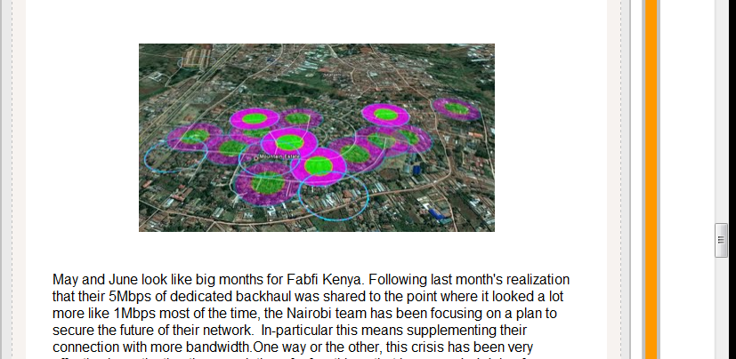
PROJECTS(COMPLETED)
Fabfi project- a wireless internet meshing
http://www.joinafrica.org/kenya/

Slide 3
Sanergy toilet project-Sanergy- making sustainable sanitation in slum area- http://saner.gy

Slide 4
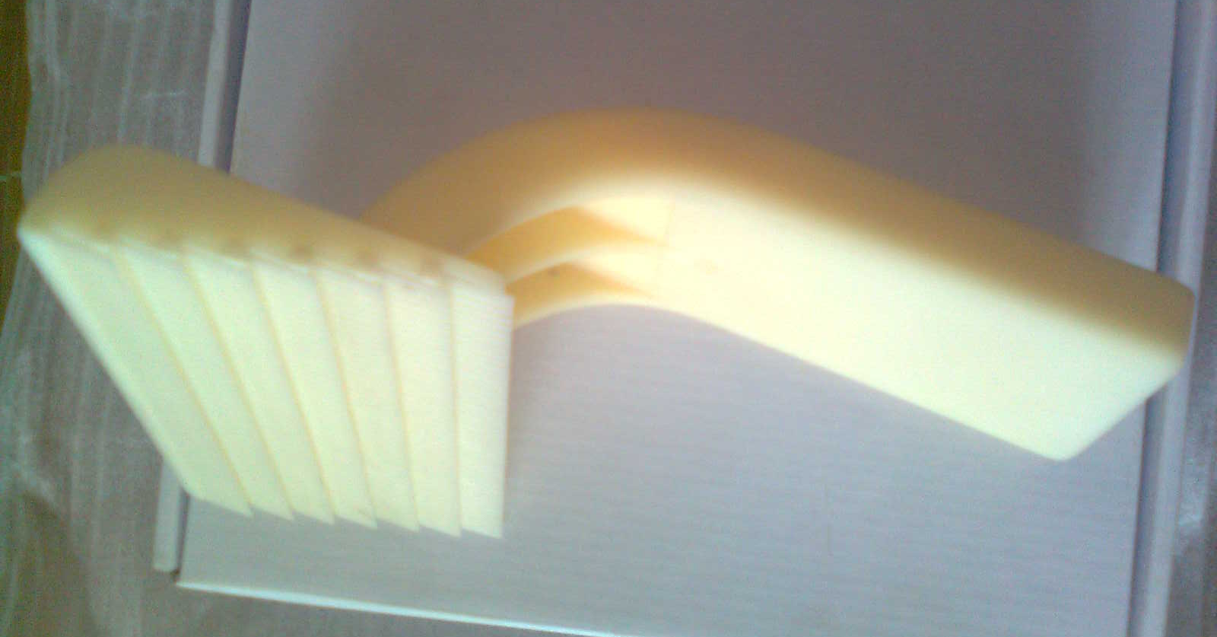
TruthComb
A new invention comb which really works through the hair cuticles -http://truthcomb.com/

Slide 5
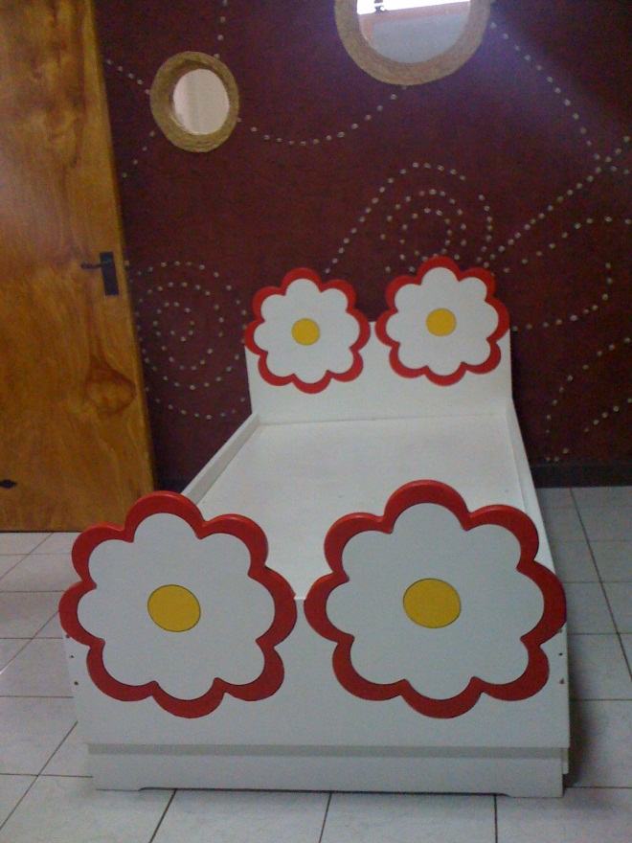
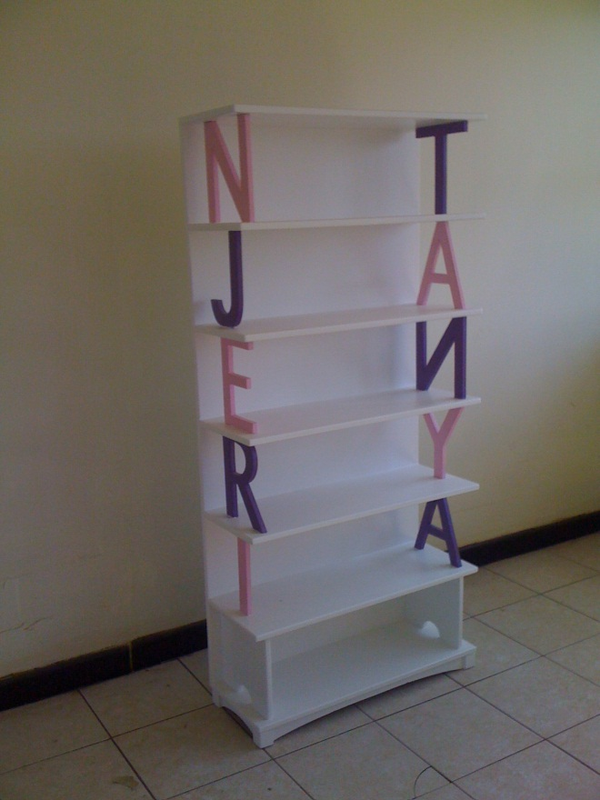
Funkidz
Making funky-functional-furniture- http://www.facebook.com/funkidz

Slide 6
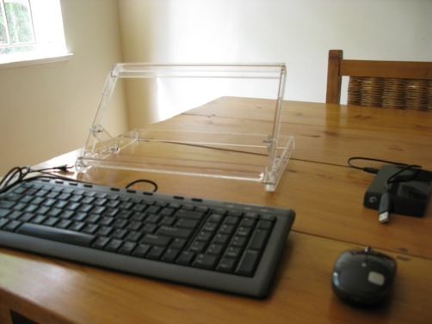
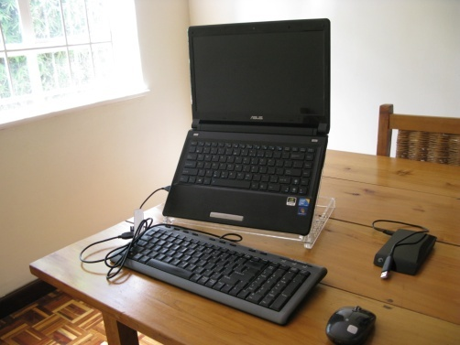
The ‘Quickstand’ ™ laptop stand
A laptop stand encourages good posture by raising your laptop’s LCD screen to a better ergonomic height.

Slide 7
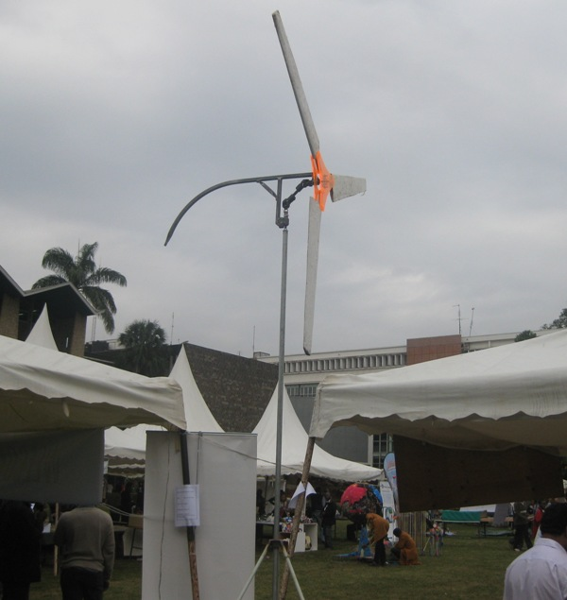
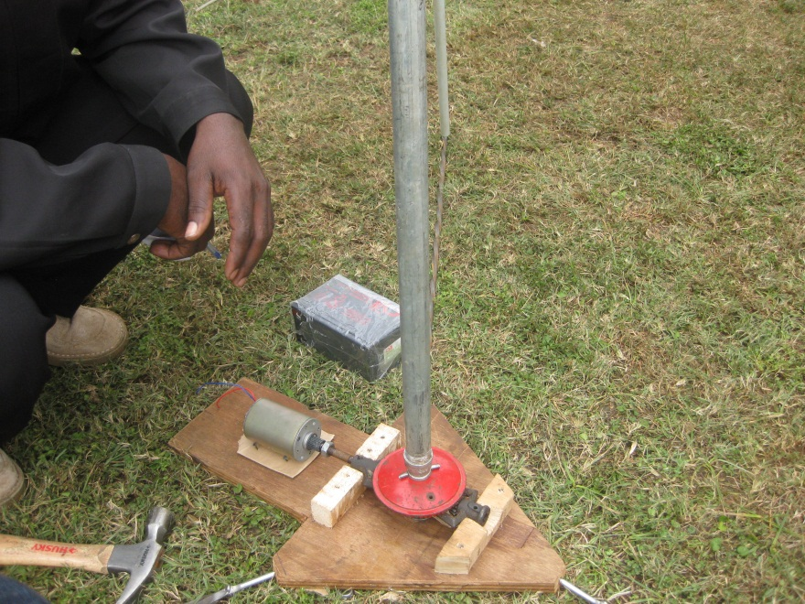
WIND TURBINE
A low cost domestic renewable energy power producer

Slide 8
LOCALIZED MANUFACTURING

